Slide 1
Programming for ECE
Week 5
Part 2:
A
R
R
A
Y
S
\0

Slide 2
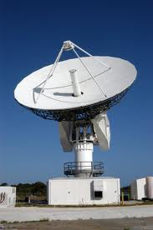
Arrays
So…
you know that you can allocate memory to store a value.
this is a variable:
int var1 ;

Slide 3

Arrays
So…
you know that you can allocate memory to store a value.
this is a variable
int var1 ;
an array:
allocates a contiguous bank of memory to hold a collection of similar values

Slide 4

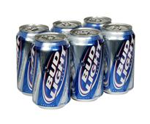
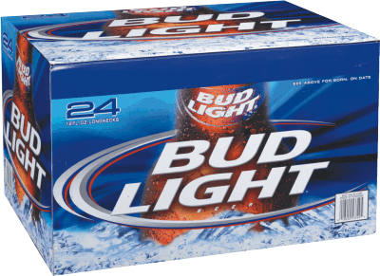
Arrays
The concept is:
Packaging variables
Beer[12]
Beer[6]
Beer[24]

Slide 5

Packaging
Consider a can of beer:
It has a type: Can
It has a name: Bud_Light
It has a value: 12 (e.g., ounces of beer)
Can Bud_Light = 12 ;

Slide 6
Packaging
You can group beer cans together:
Easier to carry
Easier to access
Easier to count
Can 1
Can 2
Can 0
Can 5
Can 4
Can 3
Can Bud_Light [6] = {12,12,12,12,12,12} ;

Slide 7
Packaging
Same principle, different size
Can Bud_Light [12] ;
Can Bud_Light [0] = 12 ;
Can Bud_Light [1] = 12 ;
Can 0
Can Bud_Light [2] = 12 ;
Can Bud_Light [3] = 12 ;
Can Bud_Light [4] = 12 ;
Can Bud_Light [5] = 12 ;
Can Bud_Light [6] = 12 ;
Can Bud_Light [7] = 12 ;
Can 11
Can Bud_Light [8] = 12 ;
Can Bud_Light [9] = 12 ;
Can Bud_Light [10] = 12 ;
Can Bud_Light [11] = 12 ;

Slide 8

Arrays
A set of same-type variables
Same type (int, bool, double, float, char)
Same Name
Different values (optional)

Slide 9
Arrays
Examples:
Can Beer[24] ;
Beer[0] = 12 ;
Beer[1] = 12 ;
Beer[23] = 12 ;

Slide 10
Arrays: Parts
Arrays act like variables (because they are variables):
They must be typed,
They must be named.
They must be sized
They must have a value before they can be used.
General declaration form:
type variable-name [number-of-elements] ;
Declaration Examples:
int myarray[10] ;
double dblarray[20] ;
char carray[5] ;
float flarrary[100] ;
bool barray[77] ;
You must declare this!

Slide 11
Arrays: Size
Arrays act like variables (because they are variables):
They must be sized
The size of the array is a measure of:
the number of elements.
type variable-name [number of elements] ;

Slide 12

Arrays: Elements
Arrays act like variables
(because they are variables):
Each element has a number
Starting with 0
Can 1
Can 2
Can 0
Can 5
Can 4
Can 3
Can Bud_Light [6];

Slide 13
Arrays: Elements
An array is:
A contiguous chunk of memory locations
called "elements"
With a single name
But
Each element can be individually addressed
myarray: elements 0-9

Slide 14
Array Rules: Declaration
You must declare an array:
int myarray[10] ;
Array Declaration
Results in this
These are names,
not values
myarray[0] myarray[1] myarray[2] myarray[3] myarray[4] myarray[5] myarray[6] myarray[7] myarray[8] myarray[9]

Slide 15
Array Rules: Values
You can assign values to the elements of an array
anytime
OR
You can initialize the elements of an array
when you declare the array.
BUT
You must initialize or assign values to elements before you use them.
myarray[0] myarray[1] myarray[2] myarray[3] myarray[4] myarray[5] myarray[6] myarray[7] myarray[8] myarray[9]
4
7
44
2
16
0
22
14
77
42

Slide 16
Array Rules: Assignment (part 1)
myarray[0] = 4 ;
myarray[1] = 7 ;
myarray[2] = 44 ;
myarray[3] = 2 ;
myarray[4] = 16 ;
myarray[5] = 0 ;
myarray[6] = 22 ;
myarray[7] = 14 ;
myarray[8] = 77 ;
myarray[9] = 42 ;
OK
This example shows assignment.
You can do this anytime
after the array has been declared.
myarray[0] myarray[1] myarray[2] myarray[3] myarray[4] myarray[5] myarray[6] myarray[7] myarray[8] myarray[9]
4
7
44
2
16
0
22
14
77
42

Slide 17
Array: Assignment (part 2)
int myarray[10] ;
int x ;
for (x = 0 ; x < 10 ; x++)
myarray[x] = x ;
OK
myarray[0] myarray[1] myarray[2] myarray[3] myarray[4] myarray[5] myarray[6] myarray[7] myarray[8] myarray[9]
0
1
2
3
4
5
6
7
8
9

Slide 18
Array: Initialization
int myarray[10]={0,7,44,0,22,1,0,0,0,0} ;
OR
int myarray[10]={0,7,44,0,22,1} ;
This example shows initialization.
You can only do this once: when
the array is declared.
OK
myarray[0] myarray[1] myarray[2] myarray[3] myarray[4] myarray[5] myarray[6] myarray[7] myarray[8] myarray[9]
0
7
44
0
22
1
0
0
0
0

Slide 19
Array: Explicit Initialization
int myarray[10]={0,7,44,0,22,1,0,0,0,0} ;
OK
myarray[0] myarray[1] myarray[2] myarray[3] myarray[4] myarray[5] myarray[6] myarray[7] myarray[8] myarray[9]
0
7
44
0
22
1
0
0
0
0

Slide 20
Array: Explicit Initialization
OK
char myarray[10]=
{'I','w','a','n','t','a','b','e','e','r'} ;
myarray[0] myarray[1] myarray[2] myarray[3] myarray[4] myarray[5] myarray[6] myarray[7] myarray[8] myarray[9]
I
w
a
n
t
a
b
e
e
r

Slide 21
Array: Implicit Initialization
int myarray[10]={0} ;
OK
myarray[0] myarray[1] myarray[2] myarray[3] myarray[4] myarray[5] myarray[6] myarray[7] myarray[8] myarray[9]
0
0
0
0
0
0
0
0
0
0

Slide 22
Array: Implicit Initialization
int myarray[10]={5, 6, 7} ;
OK
myarray[0] myarray[1] myarray[2] myarray[3] myarray[4] myarray[5] myarray[6] myarray[7] myarray[8] myarray[9]
5
6
7
0
0
0
0
0
0
0

Slide 23
Array: Implicit Initialization
Important: a value of 0 in a char variable does not mean the character '0' – it is called a "null character" or just "null"
char myarray[10]={} ;
OK
myarray[0] myarray[1] myarray[2] myarray[3] myarray[4] myarray[5] myarray[6] myarray[7] myarray[8] myarray[9]
0
0
0
0
0
0
0
0
0
0

Slide 24
Array: Implicit Initialization
char myarray[10]={'I','w','a'};
Important: a value of 0 in a char variable does not mean the character '0' – it is called a "null character" or just "null"
OK
myarray[0] myarray[1] myarray[2] myarray[3] myarray[4] myarray[5] myarray[6] myarray[7] myarray[8] myarray[9]
I
w
a
0
0
0
0
0
0
0

Slide 25


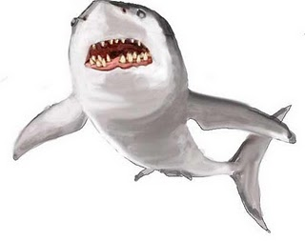

Arrays: Watchouts
Be Careful
There is a lot that you can do wrong with arrays.

Slide 26
Array: Bad Assignment
Do not do this
int myarray[10] ;
myarray[10] = 0 ;
myarray[10]
Does not exist
myarray[0] myarray[1] myarray[2] myarray[3] myarray[4] myarray[5] myarray[6] myarray[7] myarray[8] myarray[9]
0
7
44
0
22
1
0
0
0
0

Slide 27
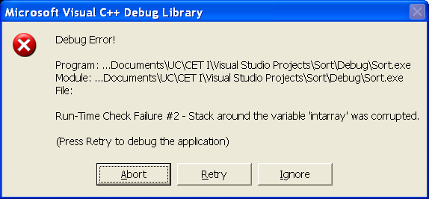
Array: Bad Assignment
int myarray[10] ;
myarray[10] = 0 ;
myarray[10]
Does not exist
You might get this.
myarray[0] myarray[1] myarray[2] myarray[3] myarray[4] myarray[5] myarray[6] myarray[7] myarray[8] myarray[9]
0
0
0
0
22
1
0
0
0
0

Slide 28
Array: Bad Assignment
myarray[10]
Does not exist
Some systems will put value of myarray[10] here.
int myarray[10] ;
myarray[10] = 0 ;
0
7
44
0
22
1
0
0
0
0
0
5
10
20
var1 var2 var3 var4
myarray[0]
myarray[9]

Slide 29
So, to recap: Bad Assignment
Do not do this
int myarray[10] ;
myarray[10] = 0 ;
myarray[10]
Does not exist
myarray[0] myarray[1] myarray[2] myarray[3] myarray[4] myarray[5] myarray[6] myarray[7] myarray[8] myarray[9]
0
7
44
0
22
1
0
0
0
0

Slide 30
Array: Accessing
int x ;
int myarray[]={0,7,44,0,22,1,0,0,0,0} ;
for (x = 0 ; x < 10 ; x++)
cout << myarray[x] << " " ;
C:\WINDOWS\System32\cmd.exe
0 7 44 0 22 1 0 0 0 0
myarray[0] myarray[1] myarray[2] myarray[3] myarray[4] myarray[5] myarray[6] myarray[7] myarray[8] myarray[9]
0
7
44
0
22
1
0
0
0
0

Slide 31
A Watchout
int myarray[10] = {0} ;
int x ;
for (x = 0 ; x <= 10 ; x++)
cout << myarray[x] << " " ;
This will compile and run…
…but may not do what you think it does.
C:\WINDOWS\System32\cmd.exe
0 0 0 0 0 0 0 0 0 0 54FF77

Slide 32
A different Watchout
int myarray[10] = {0} ;
int x ;
for (x = 1 ; x <= 10 ; x++)
cout << myarray[x] << " " ;
C:\WINDOWS\System32\cmd.exe
0 0 0 0 0 0 0 0 0 54FF77
myarray[0] myarray[1] myarray[2] myarray[3] myarray[4] myarray[5] myarray[6] myarray[7] myarray[8] myarray[9]
55
0
0
0
0
0
0
0
0
0

Slide 33
Arrays: Why Use them?
Collections of similar or related values
example: grades
char mygrades[6] ;
mygrades[0] = 'A' ;
mygrades[1] = 'B' ;
mygrades[2] = 'C' ;
mygrades[3] = 'D' ;
mygrades[4] = 'F' ;
mygrades[5] = 'W' ;
mygrades[0] mygrades[1] mygrades[2] mygrades[3] mygrades[4] mygrades[5]
A
B
C
D
F
W

Slide 34
Arrays: Why?
Collections of similar or related values
example: grades
int mygrades[6] ;
mygrades[0] = 92 ;
mygrades[1] = 55 ;
mygrades[2] = 73 ;
mygrades[3] = 63 ;
mygrades[4] = 99 ;
mygrades[5] = 81 ;
mygrades[0] mygrades[1] mygrades[2] mygrades[3] mygrades[4] mygrades[5]
92
55
73
63
99
81

Slide 35
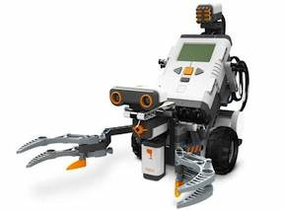
Look Familiar?
Some of you have already used arrays:
motor[motorC] = 70; // Motor C is run at a power level of 70.
motor[motorB] = 70; // Motor B is run at a power level of 70.

Slide 36
Arrays: Why?
Words (known as c strings):
char myname[6] ;
myname[0] = 'W' ;
myname[1] = 'a' ;
myname[2] = 'l' ;
myname[3] = 'd' ;
myname[4] = 'o' ;
myname[5] = '\0' ;
myname[0] myname[1] myname[2] myname[3] myname[4] myname[5]
W
a
l
d
o
0

Slide 37

Arrays: Why?
Words (known as c strings):
char myname[6] ;
myname[0] = 'W' ;
myname[1] = 'a' ;
myname[2] = 'l' ;
myname[3] = 'd' ;
myname[4] = 'o' ;
myname[5] = '\0' ;
std::cout << "My name is " << myname << std::endl ;
Single quotes for individual char elements
C:\WINDOWS\System32\cmd.exe
My name is Waldo
_
myname[0] myname[1] myname[2] myname[3] myname[4] myname[5]
W
a
l
d
o
\0

Slide 38
Arrays
Double quotes for entire char array
This works too (autosizing):
char myname[] = "Ozzy";
Note that the array has 5 elements
A null is added automatically
Integer 0 or character '\0' is called a null
myname[0] myname[1] myname[2] myname[3] myname[4]
O
z
z
y
\0

Slide 39
C Strings
Really important slide
A char array is called a "c string"
a "string" is different (next week)
If it ends with a null (0 or '\0')
The name of the char array is the name of the string
char myname[] = "Ozzy";
cout << "My name is " << myname << endl ;
C:\WINDOWS\System32\cmd.exe
My name is Ozzy
_

Slide 40

C Strings
In case you missed the last slide:
char myname[] = "Ozzy" ;
cout << "My name is " << myname << endl ;
The name of the char array is the name of the string
C:\WINDOWS\System32\cmd.exe
My name is Ozzy
_

Slide 41
C Strings
The null (\0) makes processing string arrays easy.
Ex: a stringlength function:
// prototype
int stringlength( char stringarray[] ) ;
// function stringlength counts the # of characters in a c string
int stringlength( char stringarray[] )
{
int j = 0 ;
int charcount = 0 ;
for (j = 0 ; stringarray[j] != '\0' ; j++)
{
charcount++ ;
}
return charcount ;
}

Slide 42
C Strings
A char array without a NULL terminator
is just an array of char values
it is not a C string
char cstring[3] = "is"; // is a C string
char chars[5] = { 'I', 's', 'n', 'o', 't'}; // isn't
i
s
\0
cstring[0] cstring[1] cstrring[2]
I
s
n
o
t
chars[0] chars[1] chars[2] chars[3] chars[4]

Slide 43
Warning!
This:
char myname[] = "Ozzy" ;
cout << "My name is " << myname << endl ;
Only works with a null-terminated char array.
This:
char myarray[] = {0,1,2,3,4,5,6,7,8,9};
cout << "myarray contains: " << myarray << endl ;
outputs the physical address of myarray
My name is Ozzy
_
myarray contains: 38FA91
_

Slide 44

C Strings
C strings are painful
Next week, we'll look at a better way
But, you need to know about C Strings
lots of old C programs use them
lots of C libraries use them
lots of OS functions (API) use them
lots of use on internet sites
one of those things you'll have to live with

Slide 45

Code Sample
Arrays-demo.cpp
Blackboard
Course Documents
Code Samples

